Slide 1
From Sticks and Stones to
A Functional Forensics Lab
“K” Singh

Slide 2
About Me
Started to burn money on expensive audio and other hobbies
Cylance Incident Response Forensic Lab Manager
CrowdStrike Incident Response Consultant
2017
2019
2022
2018
2019
Kaiser Permanente E-Discovery Forensics
WRCCDC “Senior” Operations Team Member Red Team Infrastructure

Slide 3
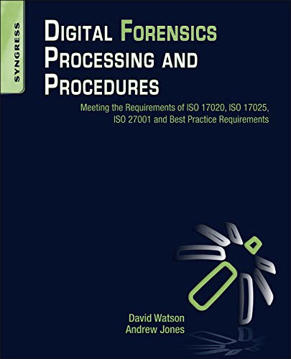
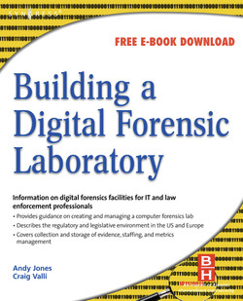
Books to keep on your Nightstand

Slide 4
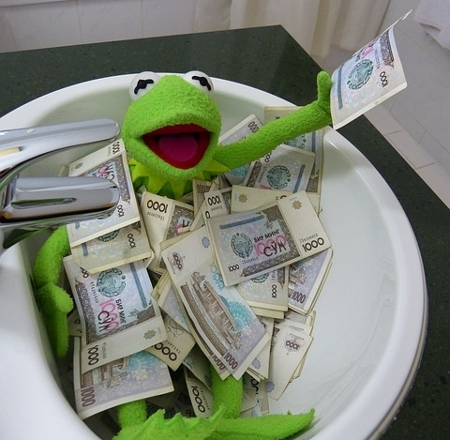

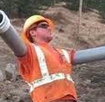

Items I will not talk about in this talk
OVERALL
PROJECT BUDGET
Varies from org to org
COMPANY
POLITICS & POLICIES
I can’t legally say you should bribe and embezzle your way towards a shiny lab but…
CONSTRUCTION SPECIFICS
Management and organization of the buildout
EVIDENCE HANDLING
CoC, Red Tape, etc.

Slide 5
A Vague Evolution of the Forensics Laboratory
1
2
3
4
5
A Clean Area for Evidence
Initially for Biological Investigations
Eventually the Digital Era Arrived
Digital Items in Evidence
Broadly speaking, there are now two kinds of labs
Standardized way to look at evidence without bias to determine how the crime/event occurred.
Murder and other not-so-fun things
Able to track people with fingerprint records, DNA, etc
Need to examine phones, laptops, etc
Traditional(Biological) vs Digital

Slide 6

Why so Serious?
Once evidence is altered, it is no longer admissible in court.
Due to many legal and historical matters, evidence can’t be altered in IR engagements or E-Disco.
The outcome of the entire case can be changed.
Now, rather than a court case, it is still a (major) internal matter.
The story needs to remain the same.

Slide 7

Different Kinds of Workflows
E-DISCO
INCIDENT RESPONSE
Dozens of TBs of Data
Workflows are much slower and require much more resources
Focused on pockets of data
Workflows need to be extremely fast and efficient for timely results
ESP in the middle of an engagement

Slide 8
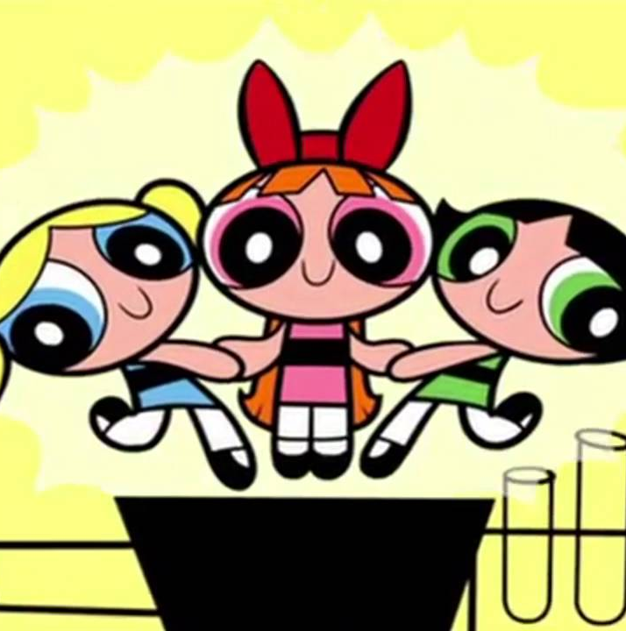
Ingredients for a Forensics Lab
Physical Location
It needs to go somewhere doesn’t it?
Compliance Requirements
Security Measures
I’m so sorry to have to talkabout this
Fort Knox without the gold
Automation & Virtualization
Workstation & Gear
Look Ma, it’s in the cloud!
r/hardware’s wet dream

Slide 9
Physical Location
01
The Actual Office Space
Close to either primary clientele or bulk of workforce
Preferably an Inconspicuous/out of the way location
02
Single Room or Multiple Rooms?
This is primarily a resource availability choice
More rooms allow for greater compartmentalization
One Room allows great cost savings
03
Room for all needed equipment
This will vary based on how big of a shop you are
This also includes all supporting equipment needed
Leave space for people as well
04
Close to Emergency Services
Not just Fire Departments for electrical fires
Doing the Heimlich Maneuver in the middle of a lab is not fun
05
Preferred Optionals
Multiple ISPs for Failover
Relatively safe from Natural Disasters
Good Food

Slide 10

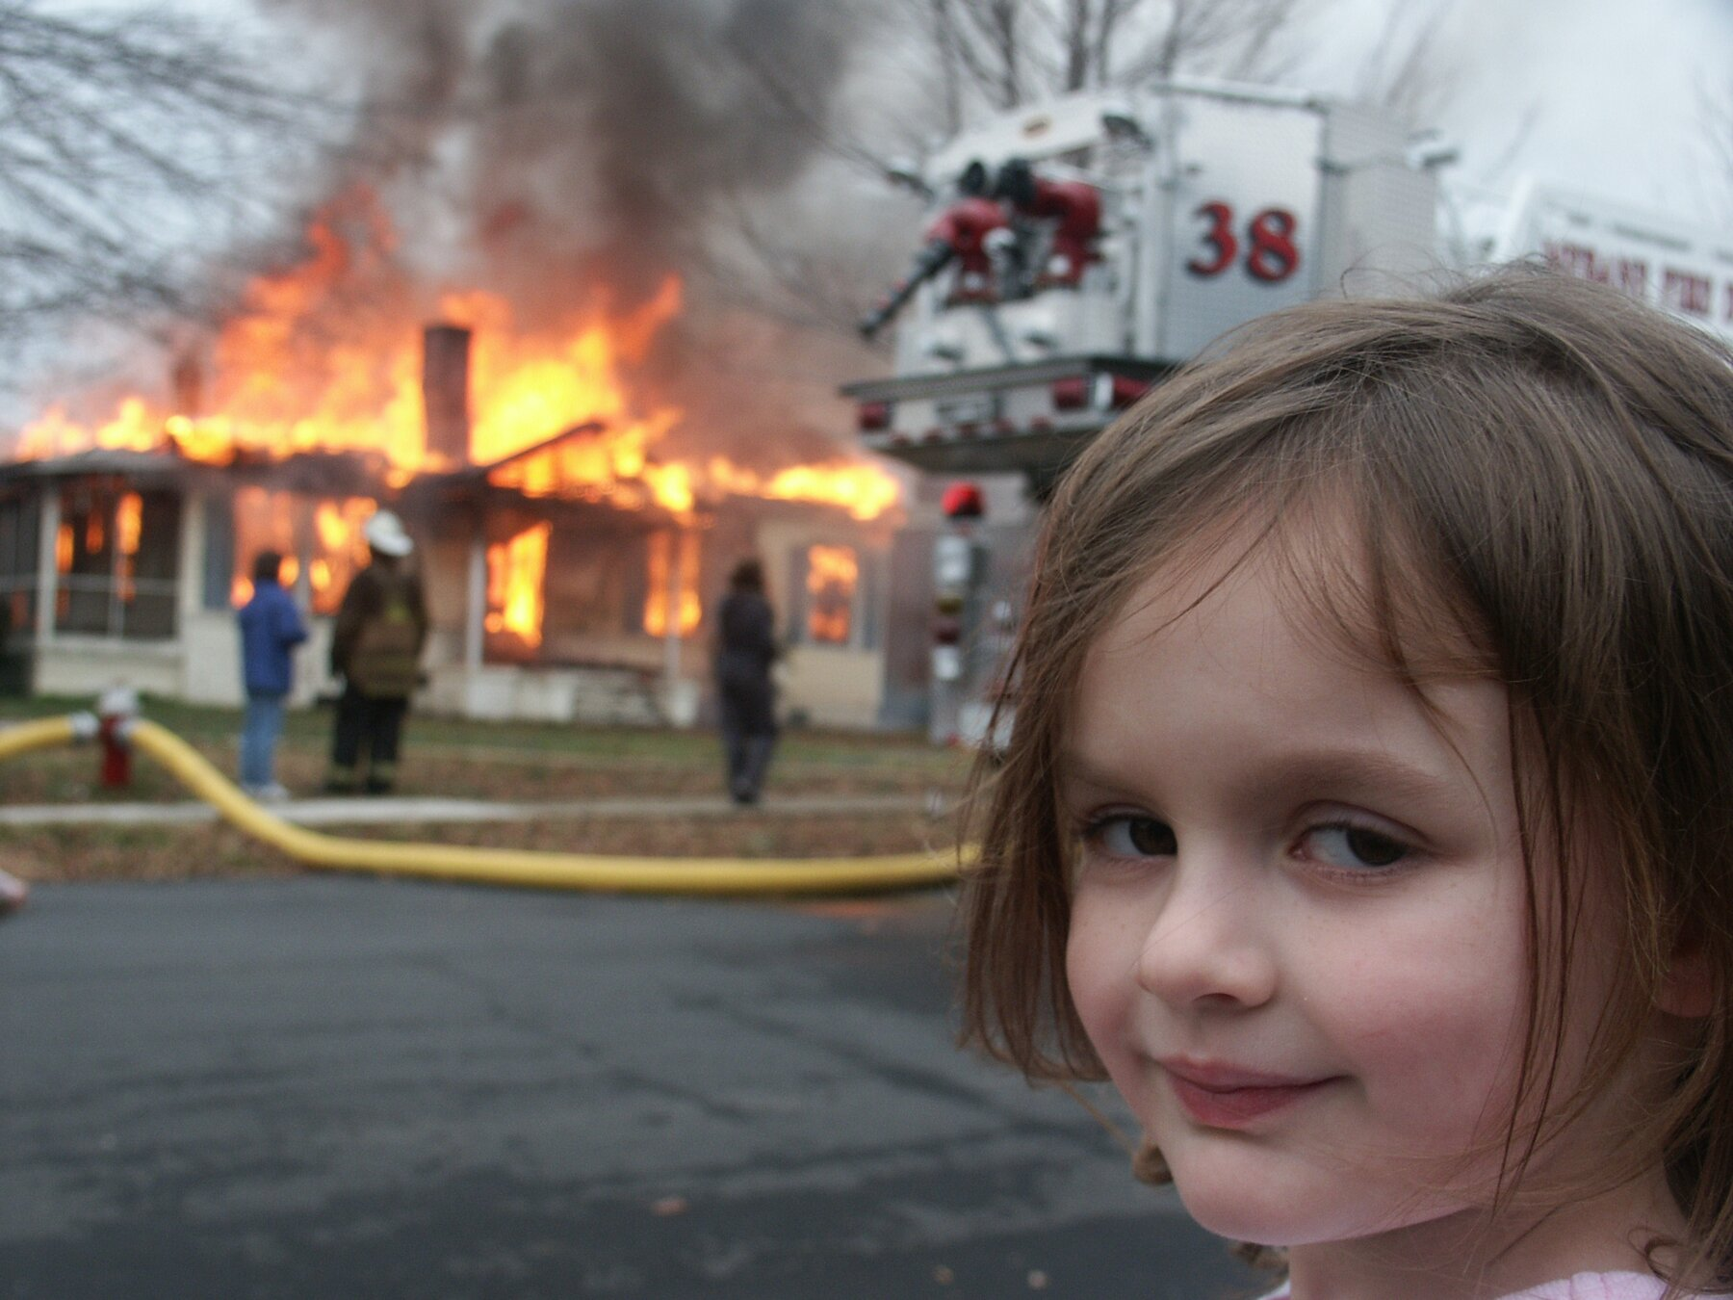



The Building Blocks
Electricity Demands Easily Satisfied
On-Site Backups, UPS, and generators
Anti-Static Measures
Flooring, Wristbands, Grounded Straps
02
04
01
03
05
Low Humidity Air Con Systems
Condensation is great on a drink, not in your workstation
Fire Suppression Systems
NOVEC 1230
Adequate Workspaces
Room for a fridge is worth!

Slide 11






Security Systems
On-Site Security
Door Sensors & Locks
24/7 Guard Duty if possible
LockPickingLawyer where you at?
Camera Systems
Evidence Safes
There’s a Big Brother joke here but I can’t see it
Supersize this
Motion Detection
Cut-proof Walls & Doors
Not even cats can bypass this
Steel Mesh/Plates

Slide 12
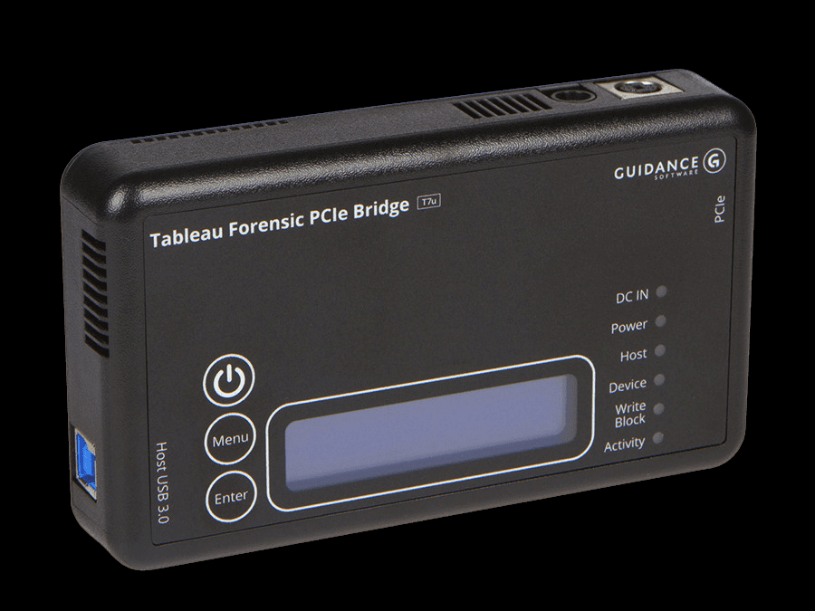
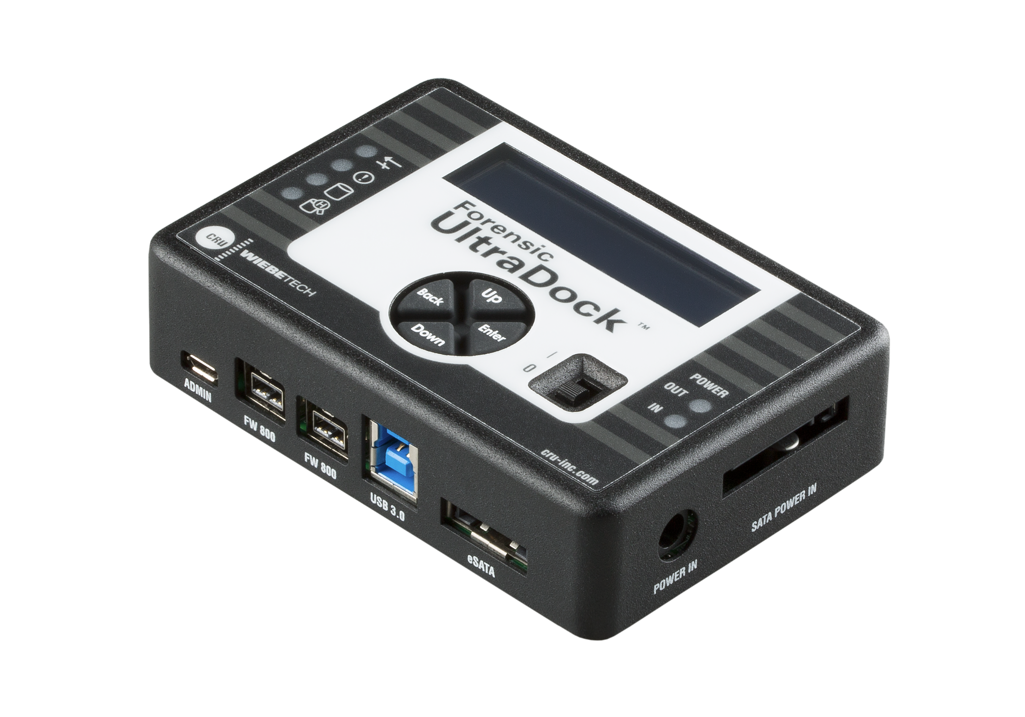
Write Blockers
Tableau
Wiebetech
Widely used and considered the universal standard of WBs
Multiple variations and types available
Pricey
Also available with multiple varieties
Not as widely used
Much more affordable
Flakier (in my experience)

Slide 13
Workstations
Really Loud Boxes
Stability and Tech Support
Forensic Workstations are simply powerful servers in desktop chassis with 5.25” bays
Systems can’t go down unexpectedly, be it from power loss or hardware failure, and if they do, you need help ASAP
All of this hardware accomplishes two things
An extremely reliable setup so there is as little as possible to no downtime for business.
And emptying your company’s coffers.
Tim Apple wants a Spot
Imaging Stations
MacOS System(s) for MacOS Specific Analysis
Have all of the evidence coming in, and none of the space? Here’s a NOS Bottle for yau

Slide 14
Faraday Box/Bag to hold device constantly
Mobile Forensics
JTAG/Chip-Off may be needed
Seperate Box for Acquisition & Analysis

Slide 15






Infrastructure
AD/DS
DNS
Certificate Authority
Your own SOC
Archival
Failsafes
Can’t have anything without one of these
It’s always DNS
And you get a cert
I really mean logging
Backups and Backups
Plans A-Z

Slide 16
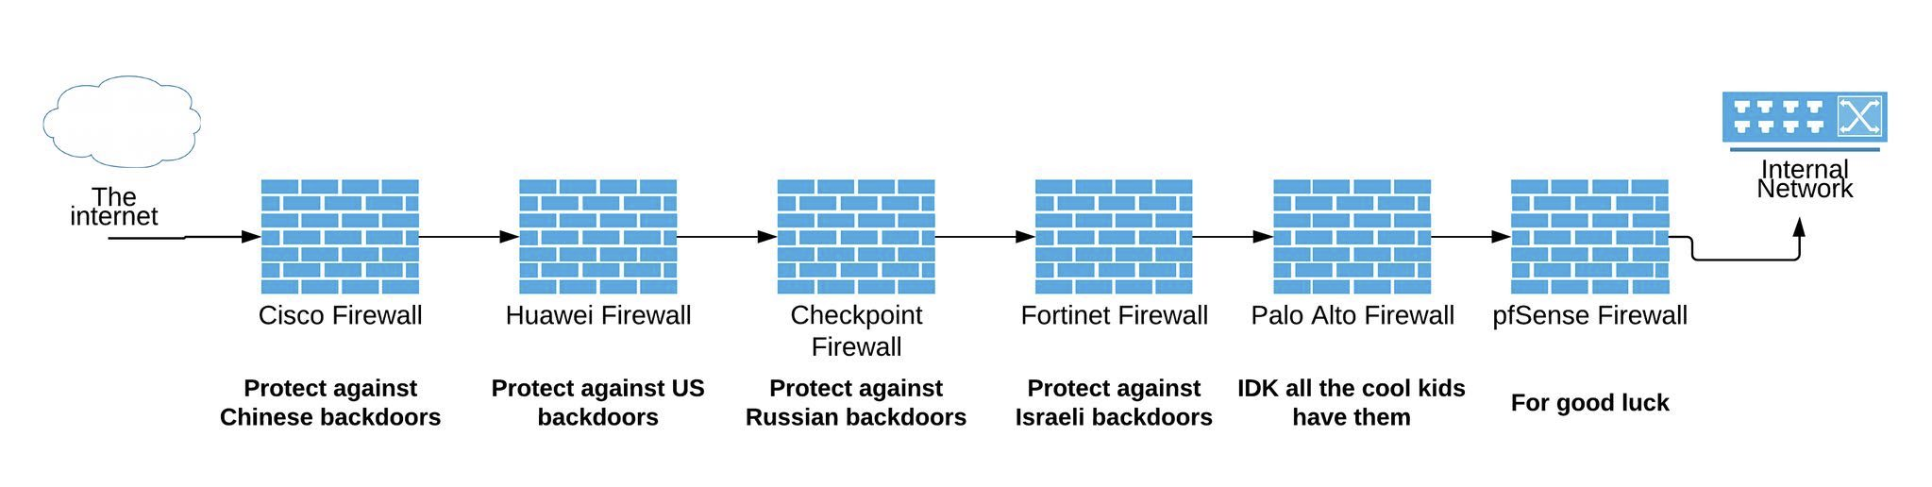
Network Structure
Option of keeping all workstations air gapped from everything but WSUS and internal shares
Can keep workstations connected to the internet but behind all the firewalls

Slide 17



Frameworks
ISO 27001
NIST 800-53
FBI CJIS
And it’s ignored cousin ISO 17025
For any Organization
Primarily for Federal Agencies and their Contractors
Aimed at Federal Agencies and Contractors handling Criminal Justice Information(CJI)

Slide 18


Attestation and Accreditation
NIST 800-53
FEDRAMP
The great-grand uncle
Now the cloud gets its time to shine
ISO 27001
FBI CJIS
CMMC
The granddaddy of them all
The rozzers are watching ya
Part two of the rozzers watching ya

Slide 19
Set up a routine for testing old and new gear
Verify your Software
Trust but Verify
Verify your Hardware
Verify Automated Processes

Slide 20
Traditional Staffing
Lab Manager
The Backbone and Bossperson of the lab. Keep them well fed
1
Triage Officer
Decides which cases will be accepted or declined, and in what order items will be looked at
2
Imaging Officer
Images all incoming evidence and manages storage
3
Analyst
Lives their life in a sea of Encase, EnScripts, and coffee
4

Slide 21
New-Age Staffing
Director
Lab Manager
Consulting Manager
Dev(Sec)Ops
Imaging Officer
Consultants
Project Managers

Slide 22
Archival & Data Retention
What does the SOW Say?
What will make me stop starting sentences with what?
What does Legal Say?
What does the budget say?
What does the client want?

Slide 23


Automation is efficiency, not laziness
Automated Processes for spinning up forensic VMs
Integration with ticketing services for statistics
How to be Lazy
Automated deployment of tooling for analysis
Self-Service Portals

Slide 24
Virtual Infrastructure
Individual boxes won’t cut it when an organization gets too large
Both Space and Monetary problems make this unviable
Moving to Virtualization is key in order to sustain growth
vSphere, OpenShift, Proxmox
vSphere assuming Broadcom doesn’t eat it alive
Cloud hosted options are possible if your pockets are deep enough
Move to VMWare Horizon or similar

Slide 25
Q&A
Twitter: @Turb0Yoda Mastodon: Turb0Yoda@haunted.computer
Blog: turb0yoda.com I don’t have a SoundCloud but I assure you my mixtape is fire

